Slide 1
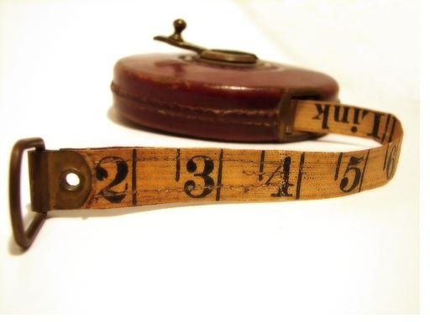
Measurements

Slide 2
SI Units
Calculations in physics are carried out in SI units, a.k.a. The Metric System
Measurement | Unit | Symbol
Length
Mass
Time
Speed
Acceleration
Force
Energy

Slide 3
Prefixes
Prefix | Symbol | Factor
mega- | M | 10⁶
kilo- | k | 10³
hecto- | h | 10²
deca- | da | 10¹
- | - | -
deci- | d | 10⁻¹
centi- | c | 10⁻²
milli- | m | 10⁻³
micro- | µ | 10⁻⁶

Slide 4
Converting Units
3 Simple Steps:
Find the decimal place
Find the factor of each prefix
Use the magic formula
Known Factor
Unknown Factor
Direction and Amount of Movement
-
=

Slide 5
Ex:
Convert 165 mm into m
Convert 380 cg into mg
Convert 24 ML into mL

Slide 6
Ex:
4) Convert 24 m/s into km/hr
When converting between m/s and km/h remember the magic number:
Km/h ÷ → m/s
m/s x → km/h
3.6
3.6

Slide 7
Scientific Notation
Ex:
32 000 000 →
0.00000436 →
Move the decimal point until only one non-zero digit remains on the left.
# of spaces moved is the exponent of 10
Move left and the exponent is “+”
Move right and the exponent is “-”

Slide 8
WARNING
When typing scientific notation into your calculator use the , or button
DON’T type it in the long way or you will waste time and make more mistakes!
E
EE
EXP

Slide 9
1. Write the following numbers in scientific notation:
a) 5,500,000,000 b) 780
c) 0.091 d) 0.000003004
2. Write the following numbers in regular notation:
a) 5.5 x 10⁻⁴ b) 7.1 x 10⁶ c) 1.0 x 10³

Slide 10
3. Compute the following:
10³ x 10⁵ b) (4x10⁻³)(5x10⁻⁵)
c) 10⁻³ x 10⁵ d) (8.0 x 10⁵)(1.2 x 10⁸)
e) 10³ ÷ 10⁵ f) (2.3 x 10⁻³)÷ (1.0 x 10⁻⁵)
g) 10⁻³ ÷ 10⁵ h) (3 x 10⁸)²

