Slide 1
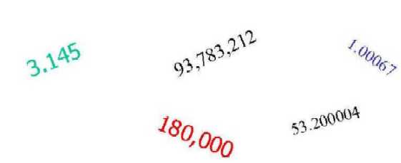
Unit 1
Significant Figures

Slide 2
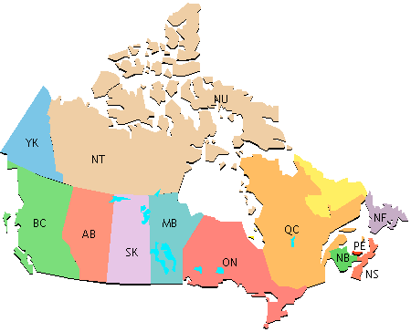
In physics we will be taking measurements and using a lot of numbers for calculations. However, we have to be aware of significant figures (sig figs) because every measurement has a certain degree of uncertainty.
Imagine Mr. Trask calls his cousin in Newfoundland and asks him how far it is from Vancouver to St John’s.
“Right on Buddy! Eet’s
5000 km. That’s exactly
5 000 000 m!!!”

Slide 3
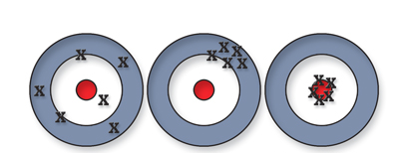
Accuracy vs. Precision
Accuracy is how close a measured value is to the correct or accepted value.
Precision refers to how reproducible your measurements are. Numbers with more digits are considered more precise.

Slide 4
When making a measurement, the last digit is always uncertain – a best guess.
All recorded data is considered significant, however the last digit is deemed uncertain.
A measuring instrument generally has a precision of +/- 0.5 of its smallest division.

Slide 5
The Sig Fig Rules
To determine how many sig figs a number has follow these rules.
1) All non-zero digits are considered significant.
Ex: 321 has ______ sig figs
2) Zeroes that occur between digits are significant.
Ex: 1001 has ______ sig figs

Slide 6
More Rules:
Going from the decimal point to the left, any zeros are not significant until you hit a non-zero.
Ex. 1001 = 4 sig. figs
Ex. 5200 = 2 sig. figs
In other words…..No decimal point? Then start at the right and start to count at the first non-zero

Slide 7
Even more rules
When it has a decimal point, you count those extra zeros!
Ex. 0.2500 = 4 sig. figs
Ex. 0.0085 = 2 sig. figs

Slide 8
3) In a non-decimal number zeroes to the right of other digits are NOT significant.
Ex: 5200 has ______ sig figs
4) Zeroes to the left of the first digit are NOT significant.
Ex: 0.0085 has ______ sig figs
5) In a decimal number zeroes to the right of the last digit are significant.
Ex: 0.2500 has ______ sig figs

Slide 9
Examples: How many sig figs are in each number?
1) 1500 2) 2021 3) 0.34
4) 0.0039 5) 50 000 6) 0.800
7) 0.000360 8)1200.00

Slide 10
Multiplying and Dividing
When multiplying or dividing numbers, our final answer is always rounded off to the least number of sig figs.
Ex: 350 x 1.15 =
200.0 x 150 =
0.002695 x 100 =

Slide 11
Addition and Subtraction
When adding or subtracting numbers our final answer must be expressed to the last digit found in BOTH of our original values.
Ex: 25 + 57.65 =
0.6851 – 0.337 =
5.024 – 5.01 =

