Slide 1
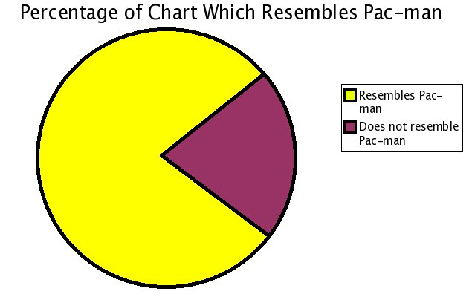
Graphing

Slide 2
Rules For Graphing
Label the axis
Manipulated Variable on the x-axis
Responding Variable on the y-axis
Give the graph an appropriate title
Scale each axis
Use as much of the graph as possible
Choose a scale that is easy to read
Factors of 1, 2, 5, 10 work best!!!
Plot the points and draw a smooth fit curve

Slide 3
Direct Relationship
y = mx + b
Slope = rise run
= y₂ – y₁ x₂ – x₁
slope
y-intercept

Slide 4
Finding Slope
To find the slope of a straight line:
Choose 2 points on the best fit line
Choose them as far apart as you can
Use only points on the line (NEVER USE DATA POINTS!!!)
Remember the equation of a line is:
y = mx + b

Slide 5
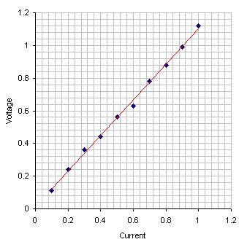
Voltage vs. Current for a Simple Circuit
Determine the slope and y-intercept of the graph shown and write the equation describing this line.
0.1
0.2
0.3
0.4
0.5
0.6

Slide 6
Name, block and date
Done in Pencil
Title
Proper Scale (Factor of 1, 2, 5, 10)
Units
Best Fit Line with a Ruler
Slope
Work Done on Graph Paper
Slopes Include Proper Units

