Slide 1
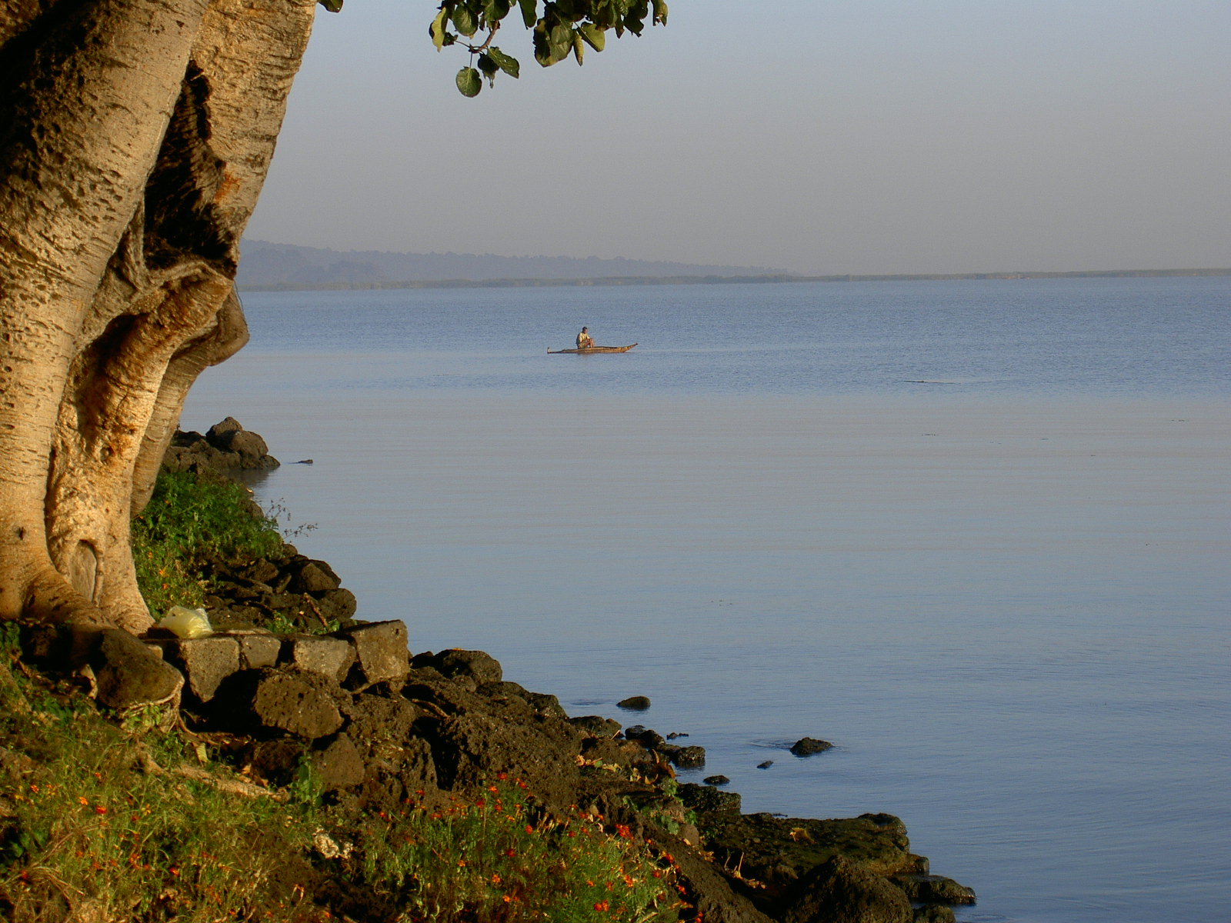
Mr. Bodnar
Science 10, Physics 11, AP Biology 11
Room 201, 204 or 205

Slide 2
Mr. G. Bodnar http://mrbodnarrockridge.weebly.com/ My Bio….(a little about me)
B. Ed. (Biology, Gen Science, PE) McGill University
MBA (Executive Management) Royal Roads University
IB (MYP, DP), AP, GCSE, IGCSE, American, South African, Indonesian, Canadian Curriculum
Personal project and Extended Essay supervisor
14 Years teaching experience
Passion = running 14 Marathons – including 4 Ultra Marathons (50, 56, 86 kms)
30 Half Marathons

Slide 3
Travelled to over 40 countries
Lived and worked in Six Countries

Slide 4
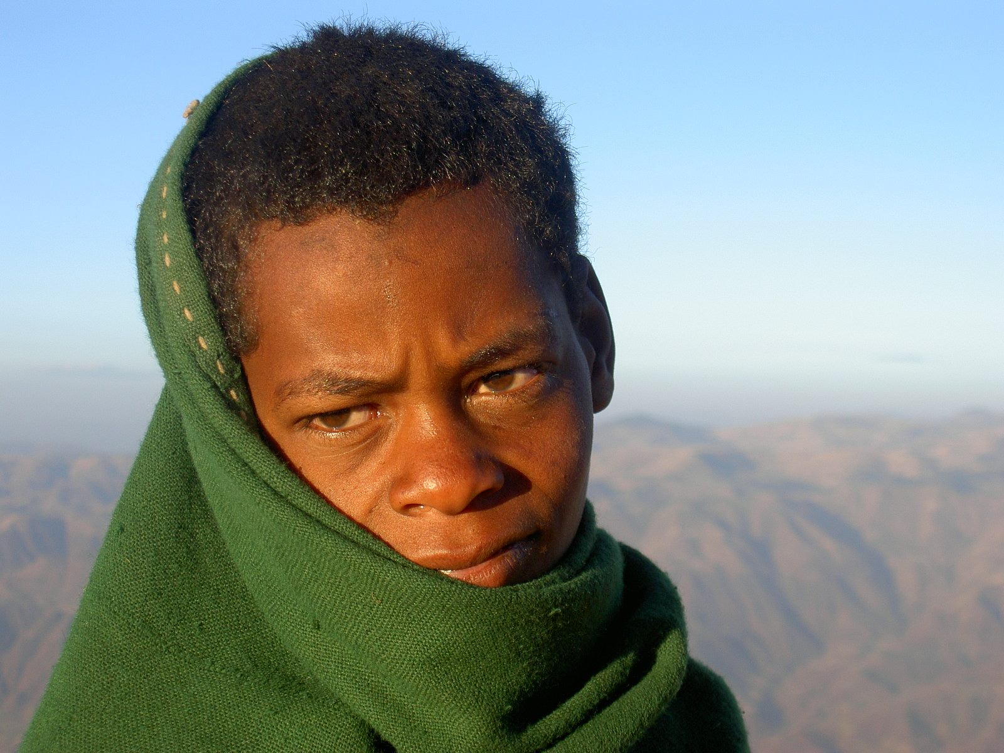

Slide 5
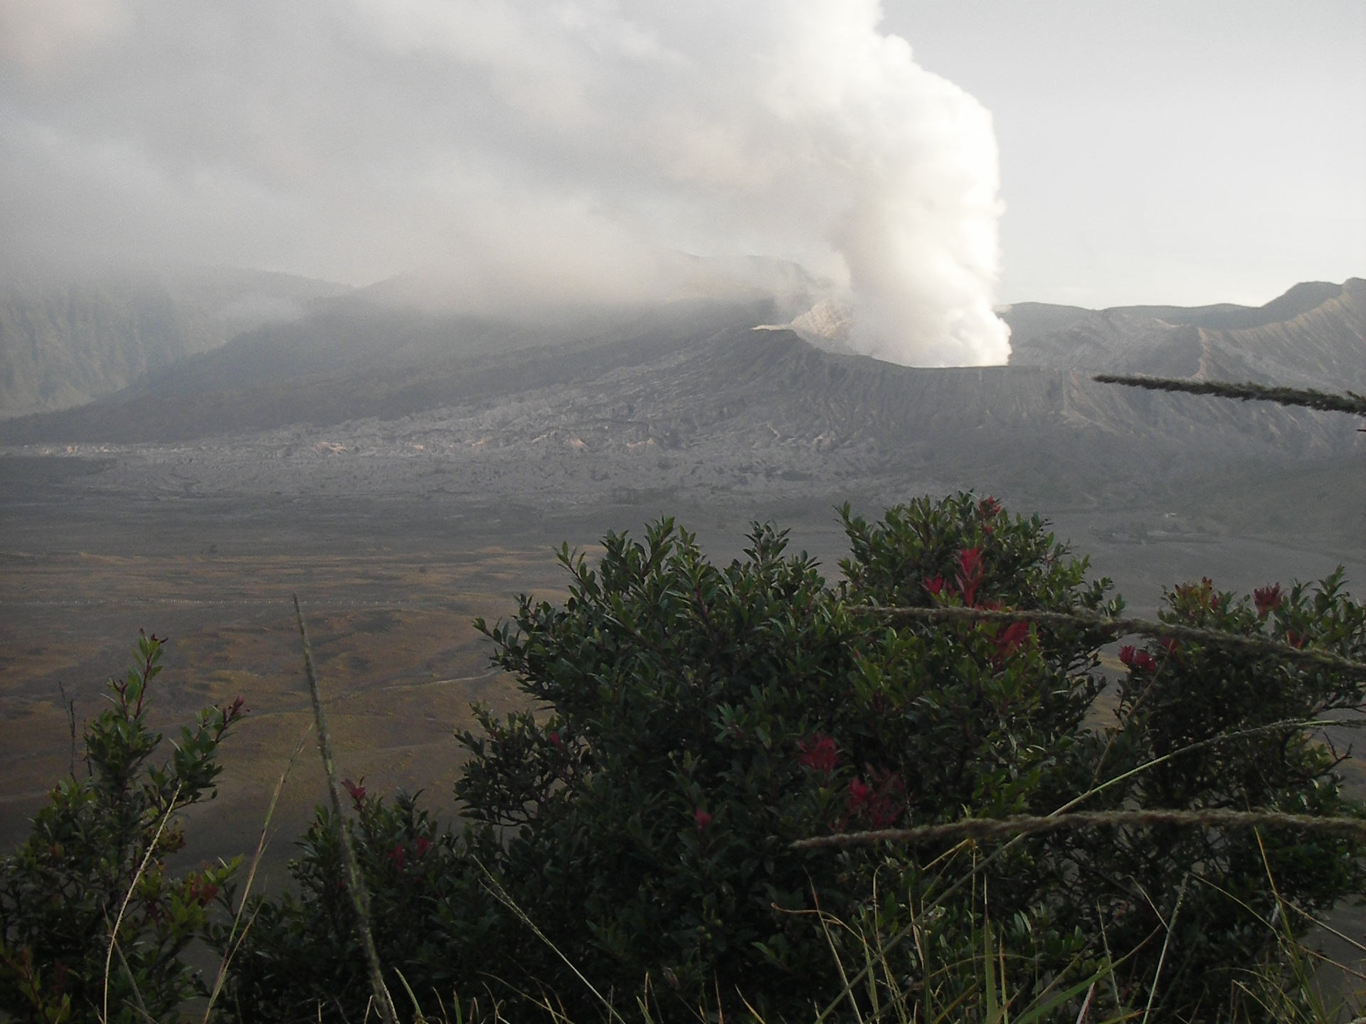
"The illiterate of the 21st century will not be those who can't read and write, but
those who cannot learn, unlearn and relearn."
Alvin Toffler
"The illiterate of the 21st century will not be those who can't read and write, but
those who cannot learn, unlearn and relearn."
Alvin Toffler"The illiterate of the 21st century will not be those who can't read and write, but
those who cannot learn, unlearn and relearn."
Alvin Toffler

Slide 6
What to expect in class
Agenda and the point we are here today….
H/W questions / Administration
Problem Solving activities
Individual / Group work
Labs / Hands on Activities
Questions assigned / project time
Reflection time (must be recorded)

Slide 7
Questions you Should be asking each and every day in here!
Why are we doing this?
How is this relevant to my world?
How is this relevant to the world outside of school?
How will this help me understand the ‘bigger’ picture?

Slide 8
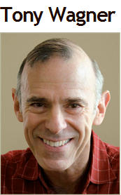
Do you have these 7 Survival Skills yet?
Critical thinking and problem solving
Collaboration across networks and leading by influence
Agility and adaptability
Initiative and entrepreneurship
Effective oral and written communication
Accessing and analyzing information
Curiosity and imagination

Slide 9
What you should be bringing each class!
Pens / pencil and eraser
3 ring binder with dividers
Lined and unlined loose-leaf paper
Agenda / Calendar
Smart phone, laptop, tablet – (I’ll explain)
Calculator: You’ll need a calculator almost every day and although phones will be permitted for a variety of in-class experiments they are not an adequate replacement for a calculator.

Slide 10
My Expectations….
RESPECT! Teacher, classmates, science lab!
Arrive on Time. If you are late = door closed. Please wait outside quietly and you will be let in when it is appropriate.
Come Prepared with all your materials
Come with an open mind!
Help each other (including me) !
Record of notes, labs, reflections….you are responsible for this on paper, cell phone, lap top, electronic copies!

Slide 11
Failure = Success
“Success is going from failure to failure without losing your enthusiasm”
Sir Winston Churchill

Slide 12
Desired Outcomes
Desired Outcomes….what are they?
Are you going to learn something in here?
What questions are you bringing to class?
What contributions are you having in class?
Notes:
Increased proficiency in inquiry skills
Increased proficiency in digital literacy skills
Children are better prepared for their future

Slide 13
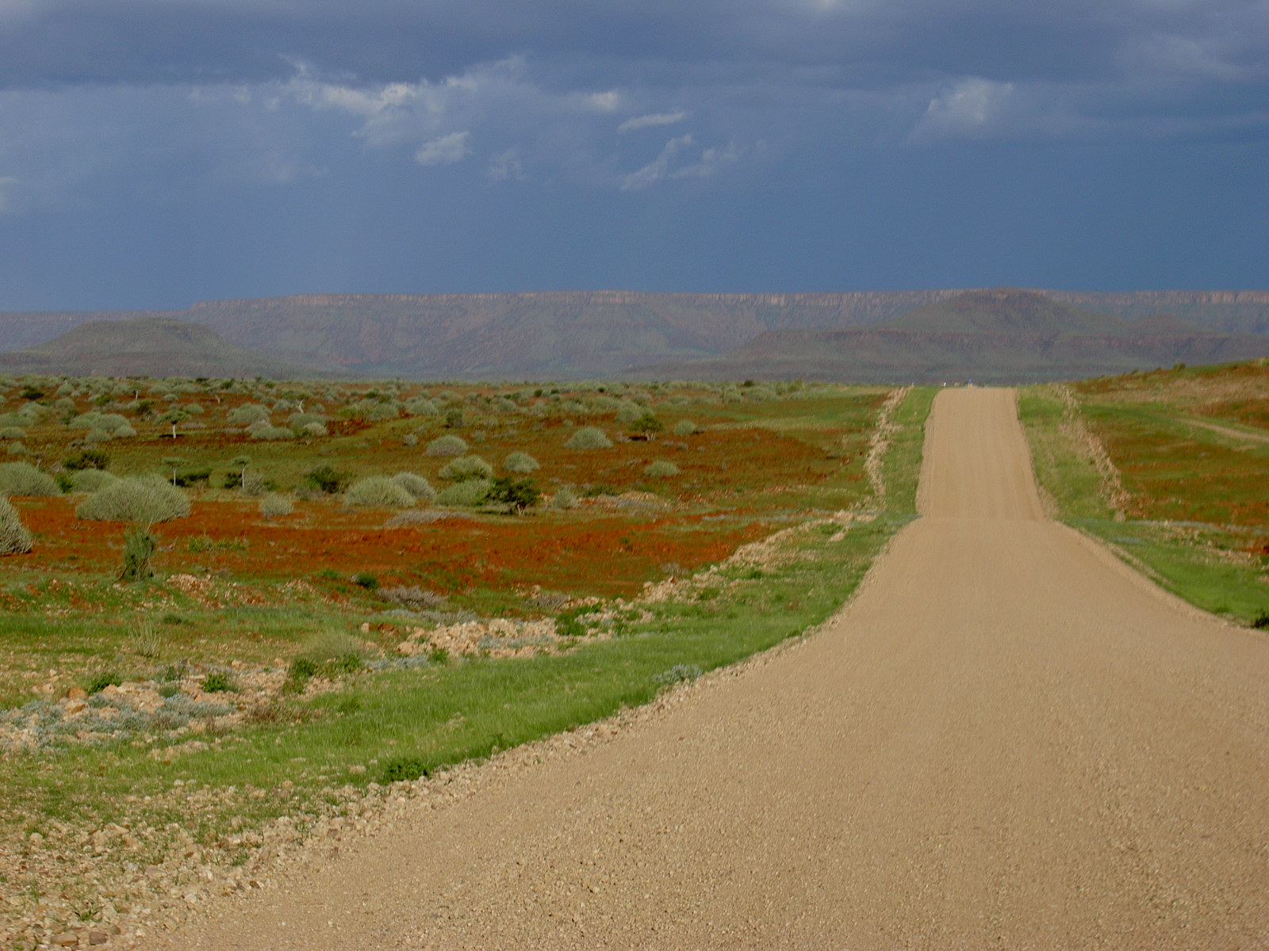
Really looking forward to teaching you this year!
Please talk to me if you are having any kind of difficulty, misunderstanding a concept, want to get extra help or just need it explained a different way!
gbodnar@sd45.bc.ca

